Slide 1

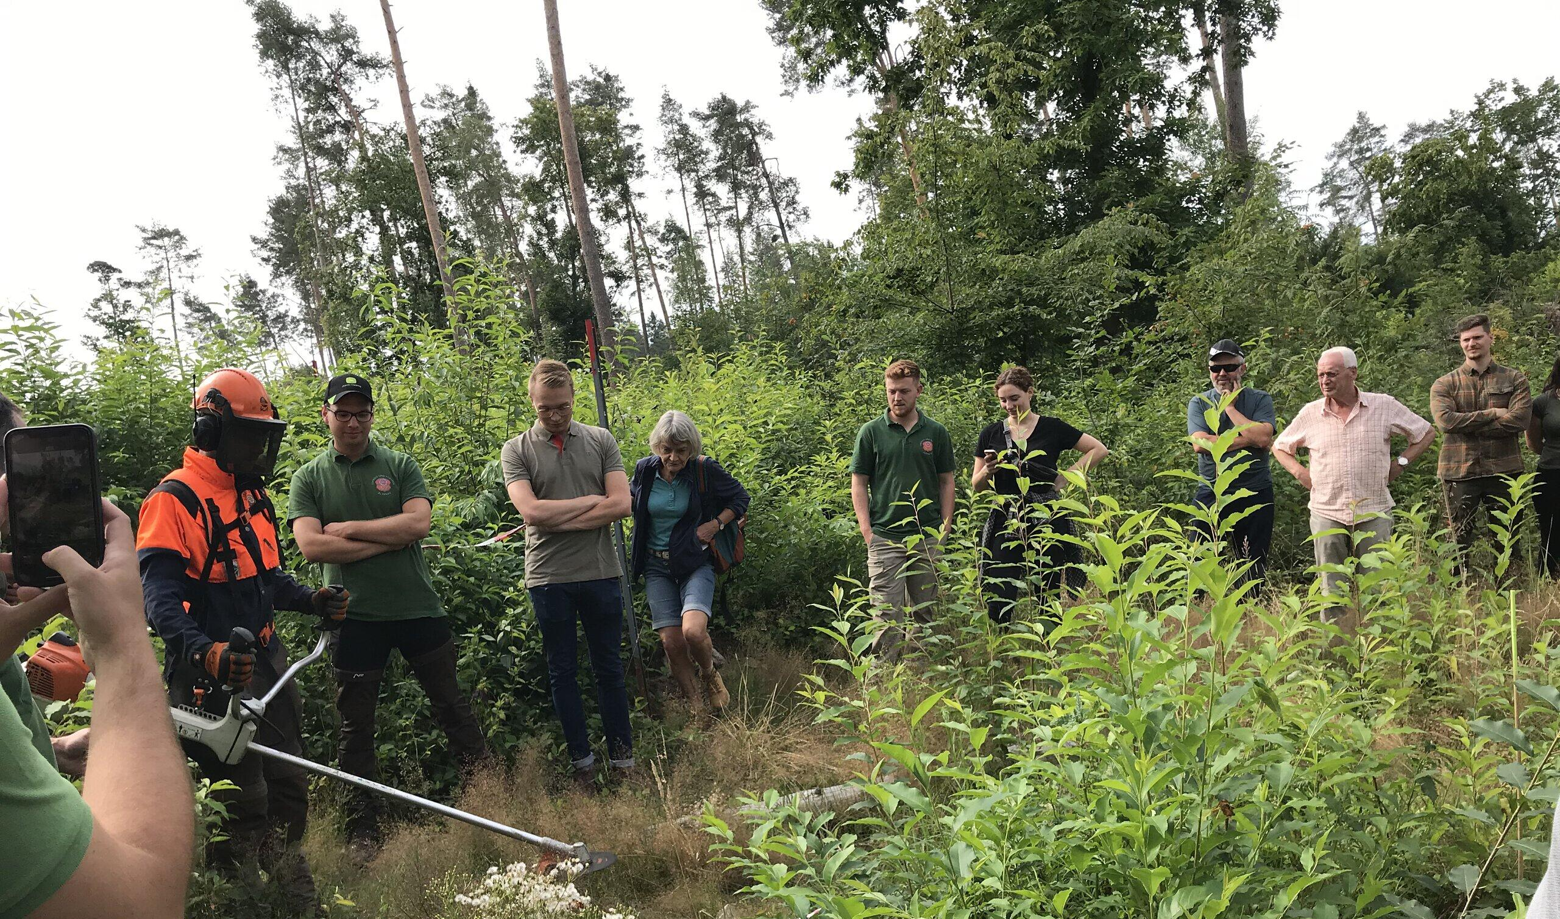
What makes an invasive tree invasive?
And how to deal with this invasiveness
ALPTREES Conference 2022
S. Michele all'Adige
Bart Nyssen

Slide 2








Ecosystem Resilience Approach
ERA
Preventing dominance
of invasive alien species by
strengthening the resilience
of forest and nature
Crassula helmsii
Lepomis gibbosus
Prunus serotina
Fallopia spp.

Slide 3

Invasive tree species, the problem
Influence forest structure and composition:
species composition: trees & schrubs, herblayer, (soil)fauna, …
soil development
forest succession
Disturb the desired forestry goals:
biodiversity
N2000 goals
wood production
Forest succession in semi-natural habitats:
grasslands, dunes, wetlands, open forests
When introducing new tree species, risk assesment is important:
case-by-case
site-by-site
goal-by-goal
Campagnaro, T., et al. (2018). "Five major invasive alien tree species in European Union forest habitat types of the Alpine and Continental biogeographical regions." Journal for Nature Conservation 43: 227-238.
Pötzelsberger, E., et al. (2020). "Growing Non-native Trees in European Forests Brings Benefits and Opportunities but Also Has Its Risks and Limits." Current Forestry Reports: 1-15.
Bindewald, A., et al. (2021). "Site‐specific risk assessment enables trade‐off analysis of non‐native tree species in European forests." Ecology and evolution.
Marinšek, A., et al. (2022). Management of non-native tree species in forests of Alpine space. Vienna, Austria, BFW.

Slide 4
Widespread
invasive tree species
‘The five major invasive alien tree species in the Alpine and Continental biogeographical regions of Europe:
ashleaf maple (Acer negundo),
tree of heaven (Ailanthus altissima),
black cherry (Prunus serotina),
red oak (Quercus rubra),
black locust (Robinia pseudoacacia)‘.
Campagnaro, T., et al. (2018). "Five major invasive alien tree species in European Union forest habitat types of the Alpine and Continental biogeographical regions." Journal for Nature Conservation 43: 227-238.

Slide 5

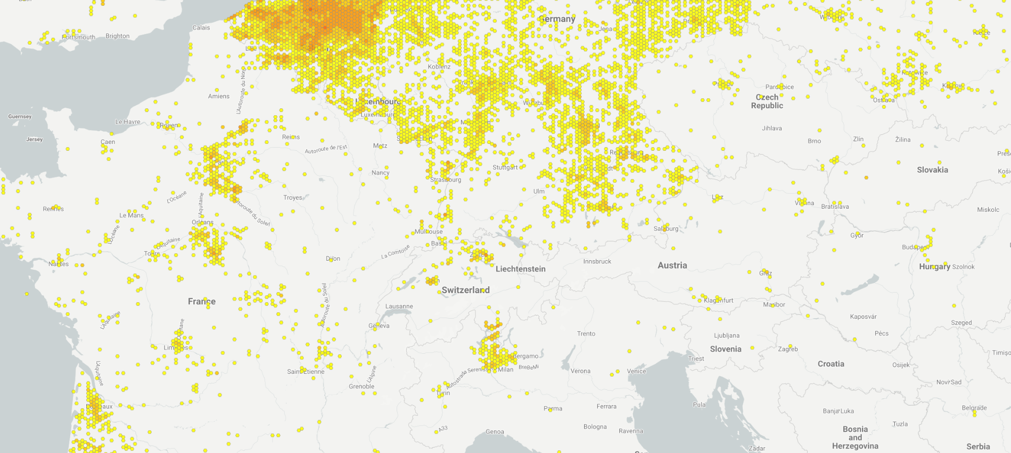
Op deze slide kun je een foto / tabel /grafiek invoegen
Black cherry (Prunus serotina)
GBIF | Global Biodiversity Information Facility https://www.gbif.org/

Slide 6
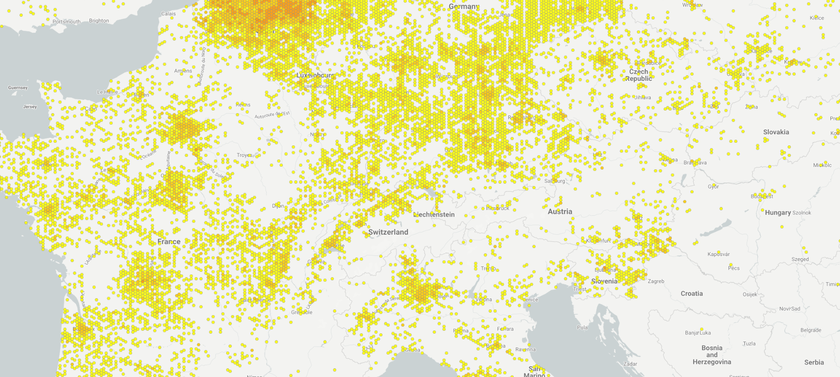
Op deze slide kun je een foto / tabel /grafiek invoegen
Red oak (Quercus rubra)
GBIF | Global Biodiversity Information Facility https://www.gbif.org/

Slide 7
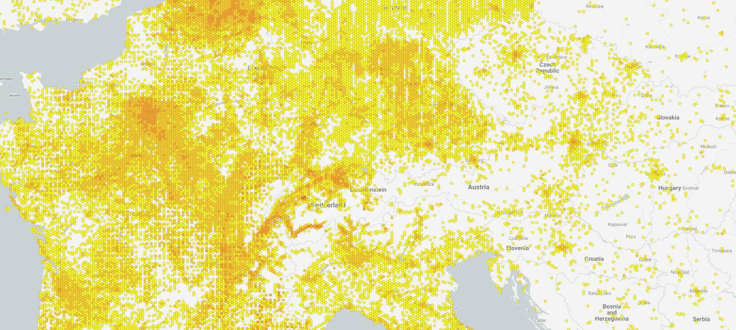
Op deze slide kun je een foto / tabel /grafiek invoegen
Black locust (Robinia pseudoaccacia)
GBIF | Global Biodiversity Information Facility https://www.gbif.org/

Slide 8
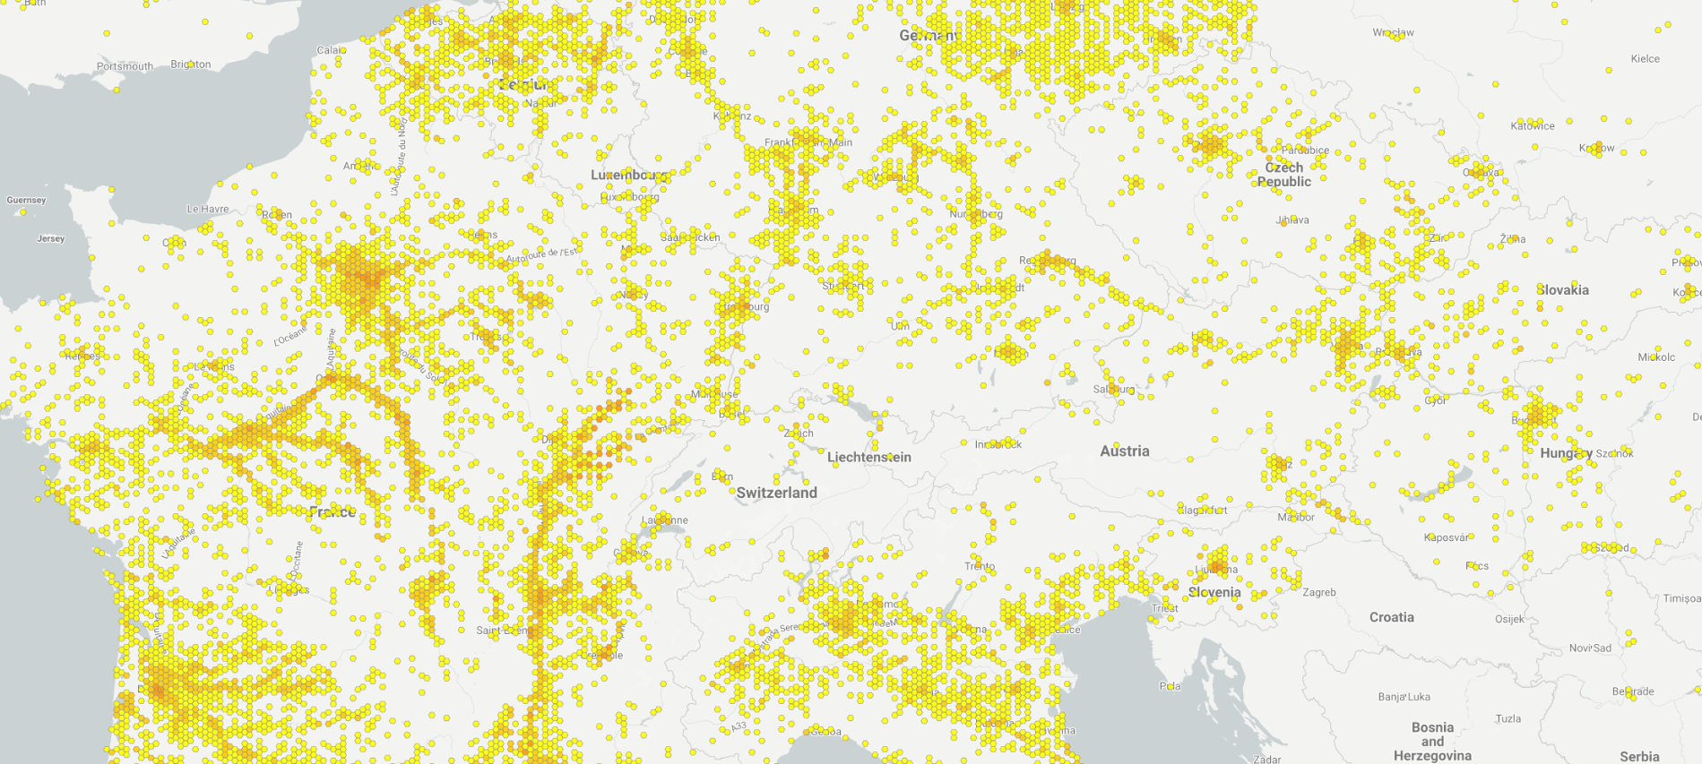
Op deze slide kun je een foto / tabel /grafiek invoegen
Box elder / ashleaf maple (Acer negundo)
GBIF | Global Biodiversity Information Facility https://www.gbif.org/

Slide 9
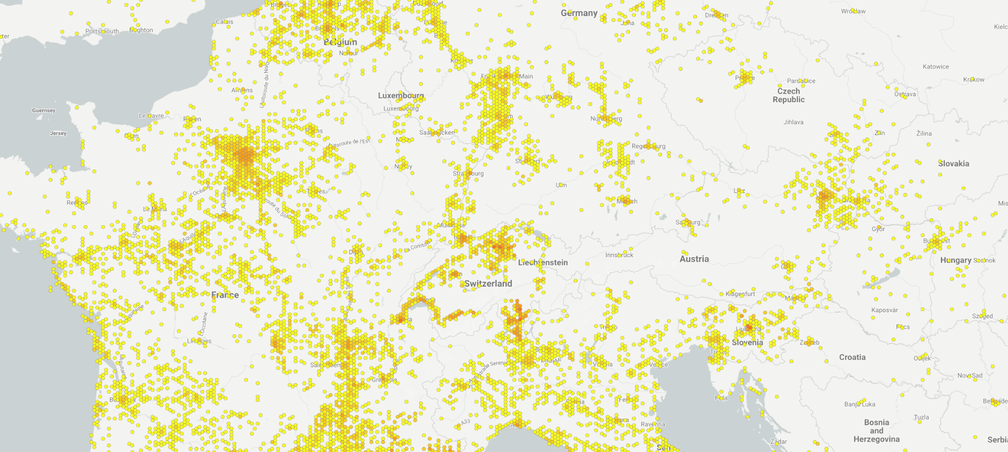
Op deze slide kun je een foto / tabel /grafiek invoegen
Tree of heaven (Ailanthus altissima)
GBIF | Global Biodiversity Information Facility https://www.gbif.org/

Slide 10

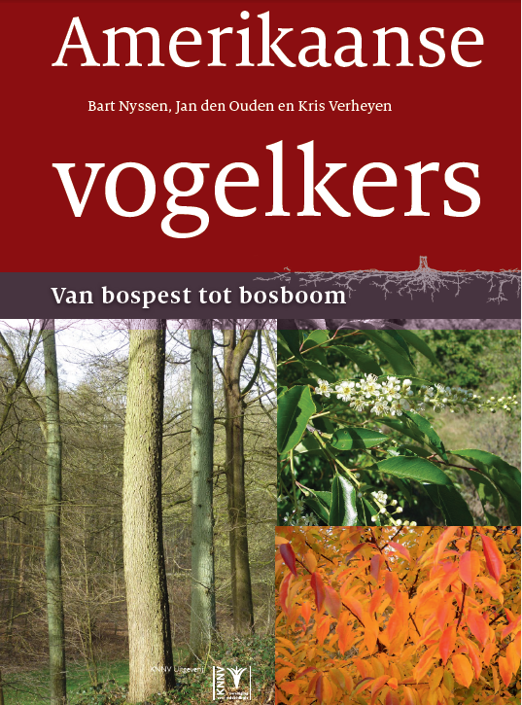
Traits of invasive tree species
abundant seed production
Seed production at a young age
easy dispersal, mostly by wind and animals
rapid juvenile growth
But
Juveniles need a lot of light
short-lived
These are basically pioneer traits
Milanović, M., et al. (2020). "Linking traits of invasive plants with ecosystem services and disservices." Ecosystem Services 42: 101072.
Dyderski, M. K. and A. M. Jagodziński (2019). "Functional traits of acquisitive invasive woody species differ from conservative invasive and native species." NeoBiota 41.

Slide 11
Species | Scientific name | Origin | Schade tolerance scale
1. Pine group |  |  | 50 –25 % of daylight
Japanese larch | Larix kaempferi | Asia | 1,38
European larch | Larix decidua | Europe | 1,46
Scots pine | Pinus sylvestris | Europe | 1,67
Black locust | Robinia pseudoaccacia | America | 1,72
Silver birch | Betula pendula | Europe | 2,03
Black pine | Pinus nigra | Europe | 2,10
2. Oak group |  |  | 25-10% of daylight
Aspen | Populus tremula | Europe | 2,22
Tree of heaven | Ailanthus altissima | Asia | 2,44
Pedunculate oak | Quercus robur | Europe | 2,45
Black cherry | Prunus serotina | America | 2,46
Ash | Fraxinus excelsior | Europe | 2,66
Sessile oak | Quercus petraea | Europe | 2,73
Red oak | Quercus rubra | America | 2,75
Douglas fir | Pseudotsuga menziesii | Amerika | 2,78
3. Maple group |  |  | 10 -5 % of daylight
Chestnut | Castanea sativa | Europe | 3,15
Field maple | Acer campestre | Europe | 3,18
Wild cherry | Prunus avium | Europe | 3,33
Ash-leaved maple | Acer negundo | America | 3,47
Hazel | Corylus avellana | Europe | 3,53
White elm | Ulmus laevis | Europe | 3,67
Sycamore | Acer pseudoplatanus | Europe | 3,73
4. Linden group |  |  | 5–2 % of daylight
Hornbeam | Carpinus betulus | Europe | 3,97
Large-leaved linden | Tilia platyphyllos | Europe | 4,00
Small-leaved linden | Tilia cordata | Europe | 4,18
Norway maple | Acer platanoides | Europe | 4,20
Norway spruce | Picea abies | Europe | 4,45
Beech | Fagus sylvatica | Europe | 4,56
Silver fir | Abies alba | Europe | 4,60
Amount of daylight seedlings and saplings need for establishing.
Example:
‘Oak forests are among the forest types most threatened by alien invasion.’
Niinemets, Ü. and F. Valladares (2006). "Tolerance to shade, drought, and waterlogging of temperate Northern Hemisphere trees and shrubs." Ecological Monographs 76(4): 521-547.
Campagnaro, T., et al. (2018). "Five major invasive alien tree species in European Union forest habitat types of the Alpine and Continental biogeographical regions." Journal for Nature Conservation 43: 227-238.

Slide 12
Invasive in native and new range
Species with pioneer traits can behave invasively in native and new range:
common ragweed (Ambrosia artemisiifolia)
giant hogweed (Heracleum mantegazzianum)
But also:
Red oak, black locust, ashleaf maple, tree of heaven
Black cherry (forest recovery New England)
Branquart, E. and G. Fried (2016). Espèces envahissantes d'ici et d'ailleurs: Synthèse sur les espèces envahissantes et présentation de 32 espèces, Mardaga.

Slide 13
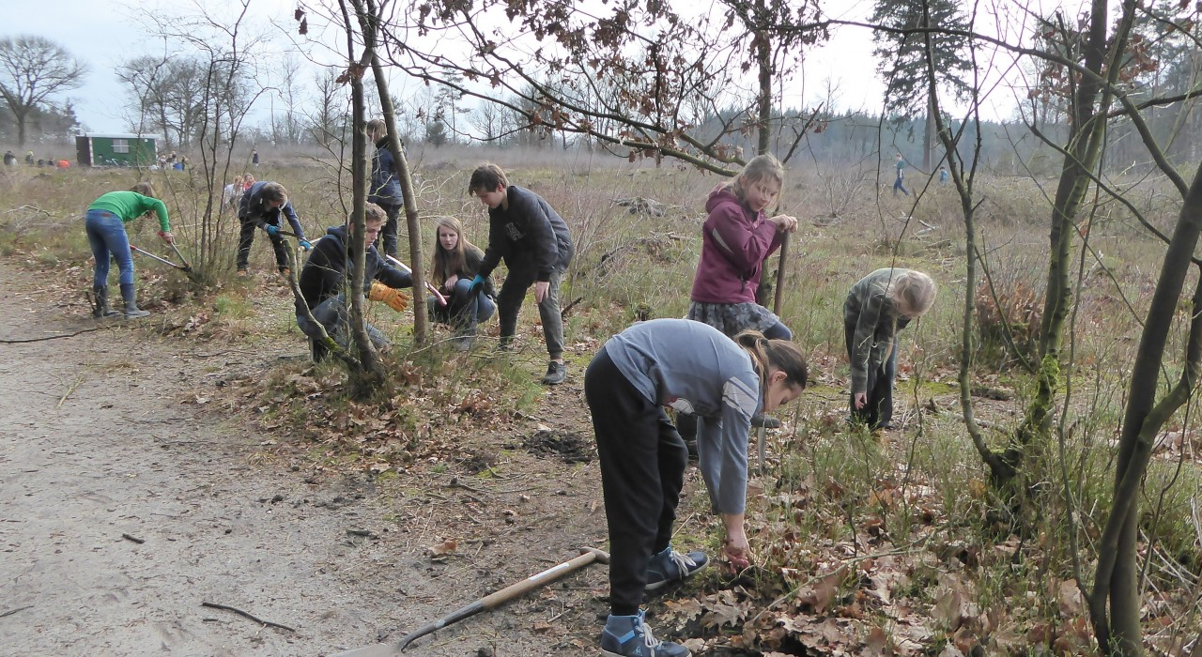
Invasive or pioneer?
removal of Scots pine and Silver birch
Notes:
Dutch nature conservationist are proud of heathlands.

Slide 14
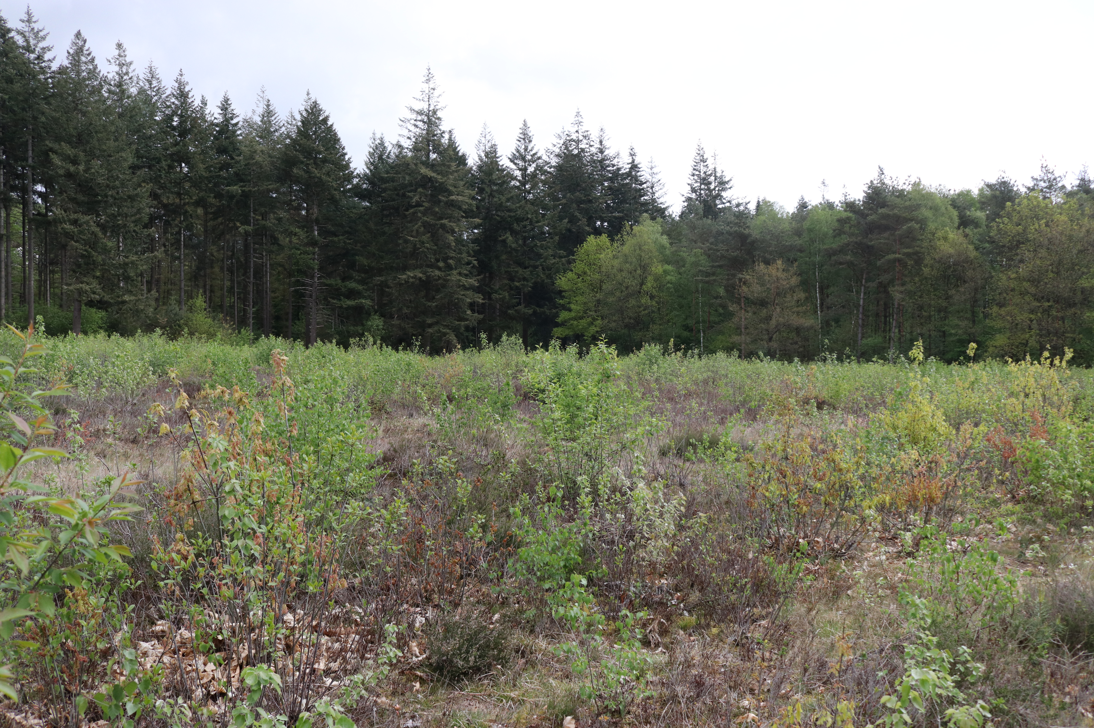
Pioneer silver birch and invasive alien species black cherry ?
Notes:
Dutch nature conservationist are proud of heathlands.

Slide 15
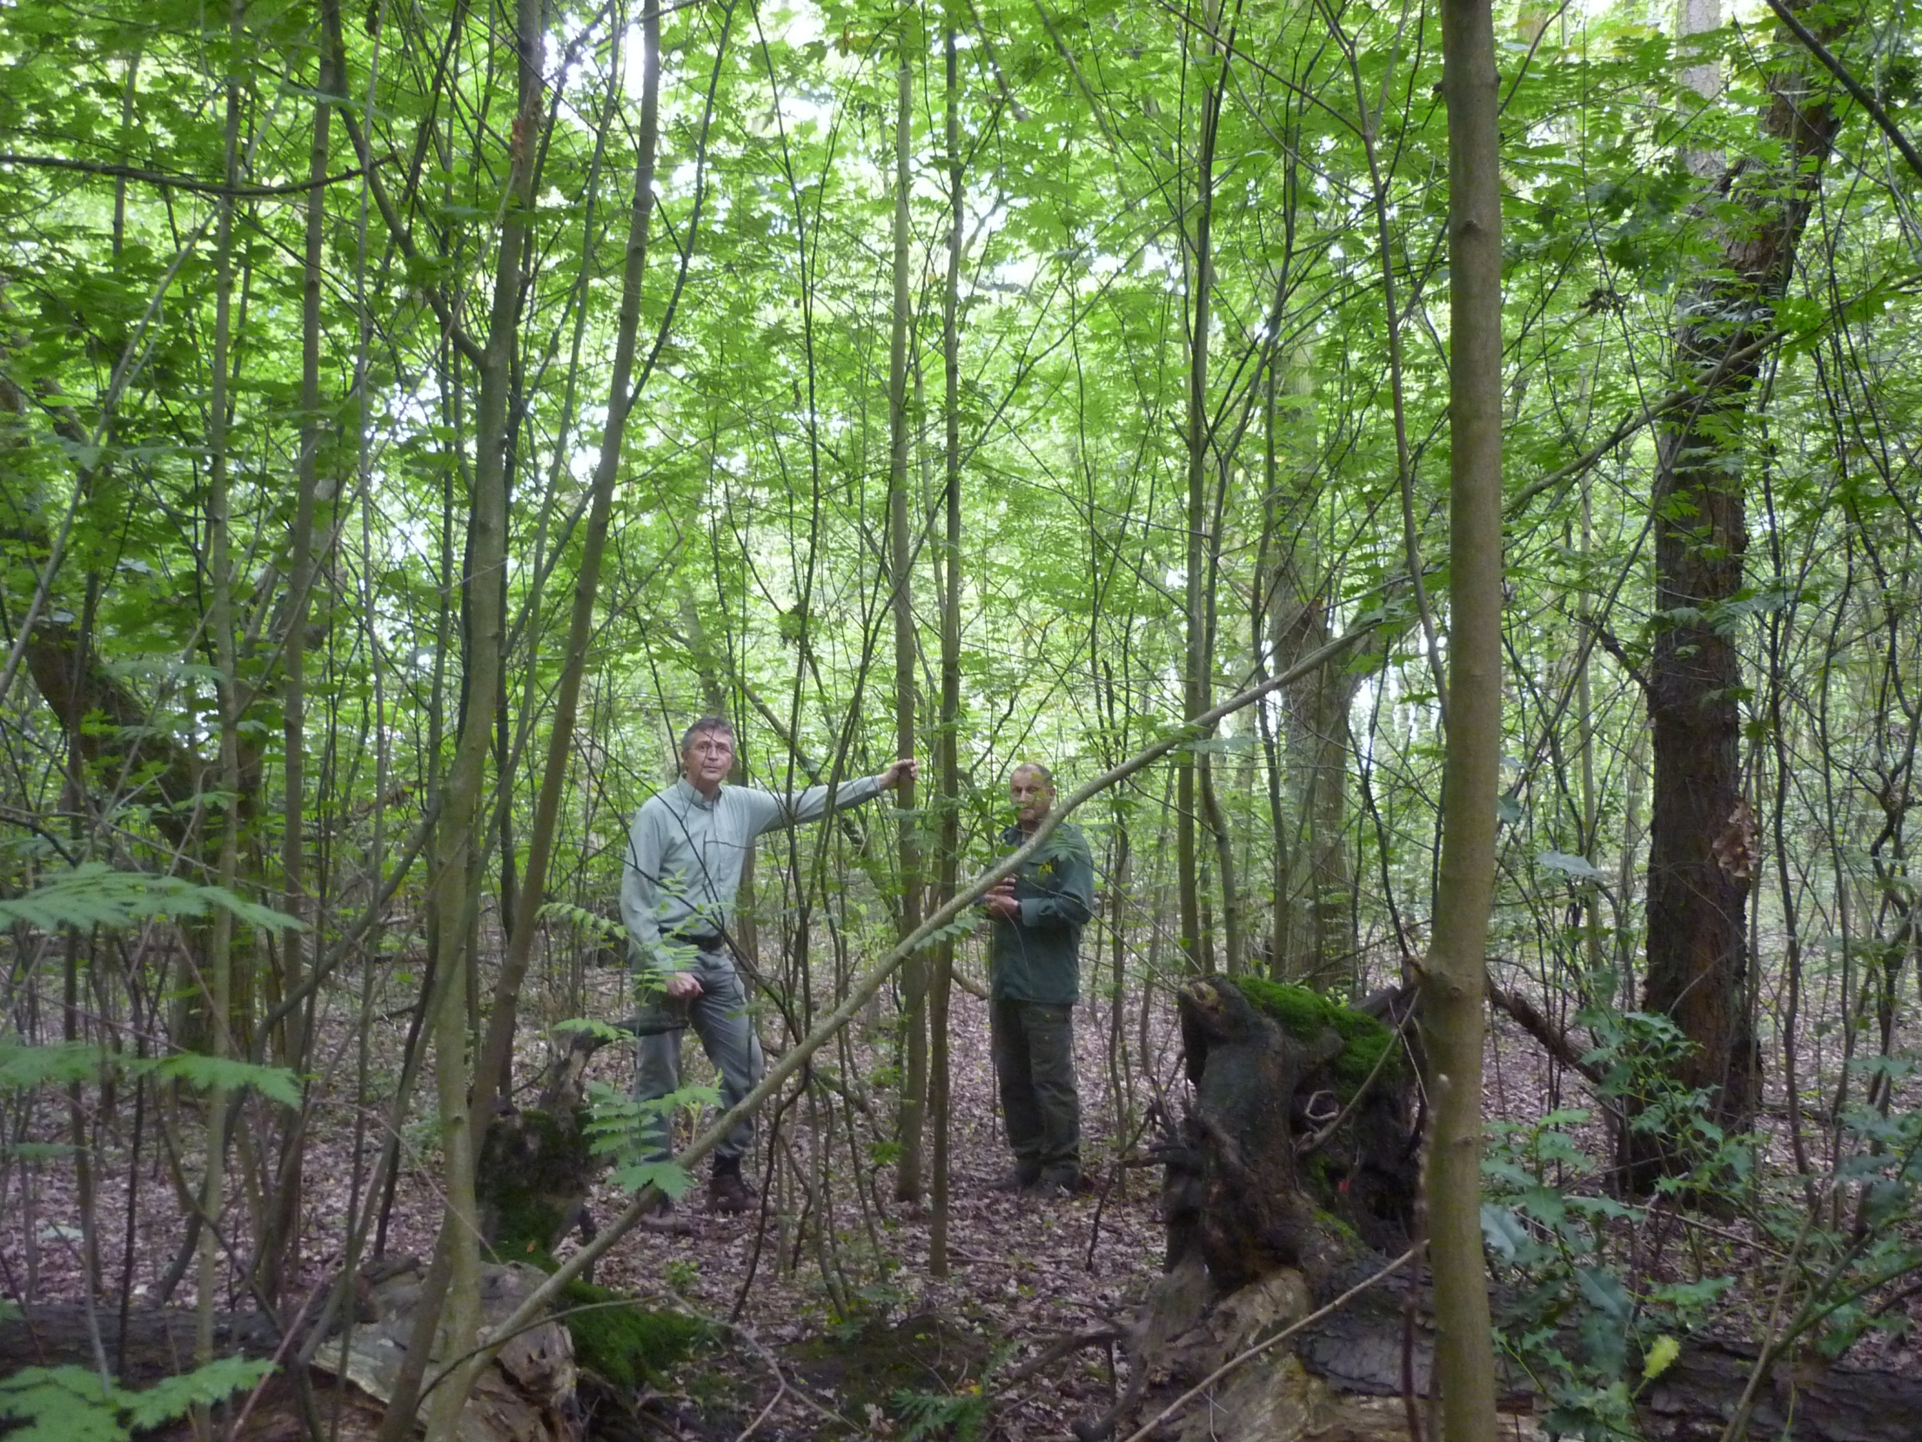
Pioneer black cherry cannot succeed itself in mixed structured forests

Slide 16
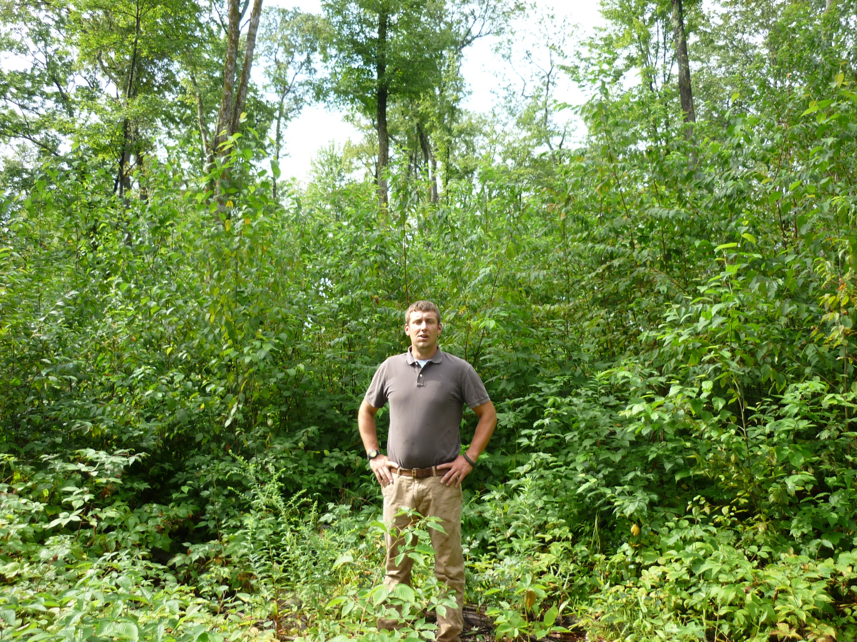
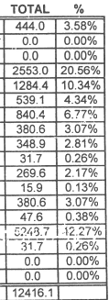

New England: ‘herbiciding’ needed when rejuvenating Black cherry
Notes:
New England foresters are proud of black cherry rejuvenation

Slide 17



What conditions make invasive tree species invasive?
Variabele Y
Variabele X
Variabele Z
Notes:
Omgeving is te beschrijven met natuurlijk optredende variatie in verschillende parameters. Bijv. vochtigheid, beschikbaarheid van voedsel, beschikbaarheid van schuilgelegenheid.

Slide 18
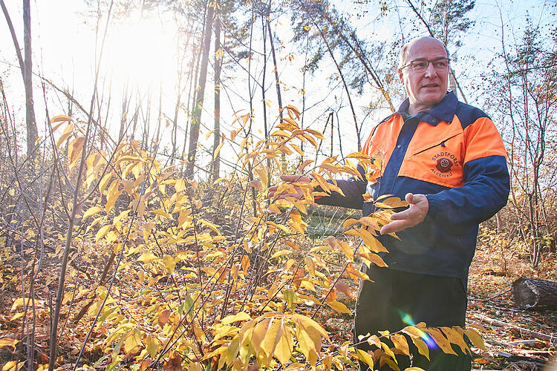
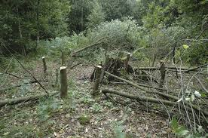
What conditions make invasive tree species invasive?
Disturbance
Notes:
Natuurlijk proces is dat inheemse soorten deze ruimte gaan benutten. Wanneer er een verstoring optreedt en er soorten/individuen sterven, is er ruimte voor vestiging van nieuwe soorten. Invasieve exoten zijn daar heel erg goed in. Voorbeeld daarvan is uitheemse watercrassula die sterk uitbreid agv plagwerkzaamheden.

Slide 19
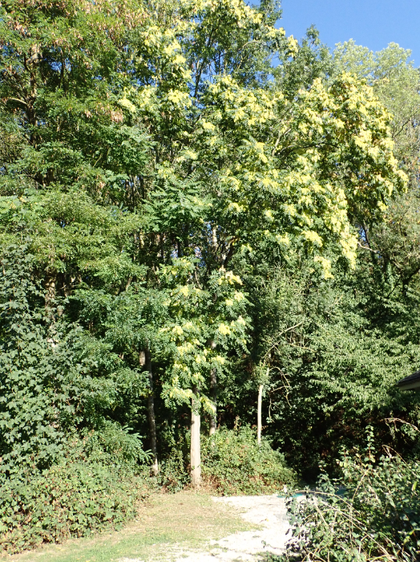
What conditions make invasive tree species invasive?
Change
Notes:
Ook veranderingen in omgeving (stikstof, klimaat, …) leiden tot nieuwe lege niches die door nieuwkomers ingenomen kunnen worden.

Slide 20
What conditions make invasive tree species invasive?
Unused resources:
Light
Nutrients
Moisture
= there is insufficient competition for these resources
Main resource for potentially invasive (pioneer) tree species =
Light
Gómez, P., et al. (2019). "Maintaining close canopy cover prevents the invasion of Pinus radiata: Basic ecology to manage native forest invasibility." PLoS ONE 14(5): e0210849.
Notes:
New England foresters are proud of black cherry rejuvenation

Slide 21
Species | Scientific name | Origin | Schade tolerance scale
1. Pine group |  |  | 50 –25 % of daylight
Japanese larch | Larix kaempferi | Asia | 1,38
European larch | Larix decidua | Europe | 1,46
Scots pine | Pinus sylvestris | Europe | 1,67
Black locust | Robinia pseudoaccacia | America | 1,72
Silver birch | Betula pendula | Europe | 2,03
Black pine | Pinus nigra | Europe | 2,10
2. Oak group |  |  | 25-10% of daylight
Aspen | Populus tremula | Europe | 2,22
Tree of heaven | Ailanthus altissima | Asia | 2,44
Pedunculate oak | Quercus robur | Europe | 2,45
Black cherry | Prunus serotina | America | 2,46
Ash | Fraxinus excelsior | Europe | 2,66
Sessile oak | Quercus petraea | Europe | 2,73
Red oak | Quercus rubra | America | 2,75
Douglas fir | Pseudotsuga menziesii | Amerika | 2,78
3. Maple group |  |  | 10 -5 % of daylight
Chestnut | Castanea sativa | Europe | 3,15
Field maple | Acer campestre | Europe | 3,18
Wild cherry | Prunus avium | Europe | 3,33
Ash-leaved maple | Acer negundo | America | 3,47
Hazel | Corylus avellana | Europe | 3,53
White elm | Ulmus laevis | Europe | 3,67
Sycamore | Acer pseudoplatanus | Europe | 3,73
4. Linden group |  |  | 5–2 % of daylight
Hornbeam | Carpinus betulus | Europe | 3,97
Large-leaved linden | Tilia platyphyllos | Europe | 4,00
Small-leaved linden | Tilia cordata | Europe | 4,18
Norway maple | Acer platanoides | Europe | 4,20
Norway spruce | Picea abies | Europe | 4,45
Beech | Fagus sylvatica | Europe | 4,56
Silver fir | Abies alba | Europe | 4,60
Amount of daylight seedlings and saplings need for establishing.
Niinemets, Ü. and F. Valladares (2006). "Tolerance to shade, drought, and waterlogging of temperate Northern Hemisphere trees and shrubs." Ecological Monographs 76(4): 521-547..

Slide 22
What forests are invasible?
Poorly structured unmixed forests with a translucent canopy Forests with regularly recurring disturbances (clear-cutting, coppicing, flooding, storm, extreme drought, …)
Pine and oak monocultures; (former) plantations.
Forests recovering from overexploitation and deforestation.
Far-from-nature forests
Nyssen, B., et al. (2018). "Spätblühende Traubenkirsche: Waldpest oder Waldbaum, je nach Waldbaukontext. " Schweizerische Zeitschrift fur Forstwesen 169(2): 93-101.

Slide 23
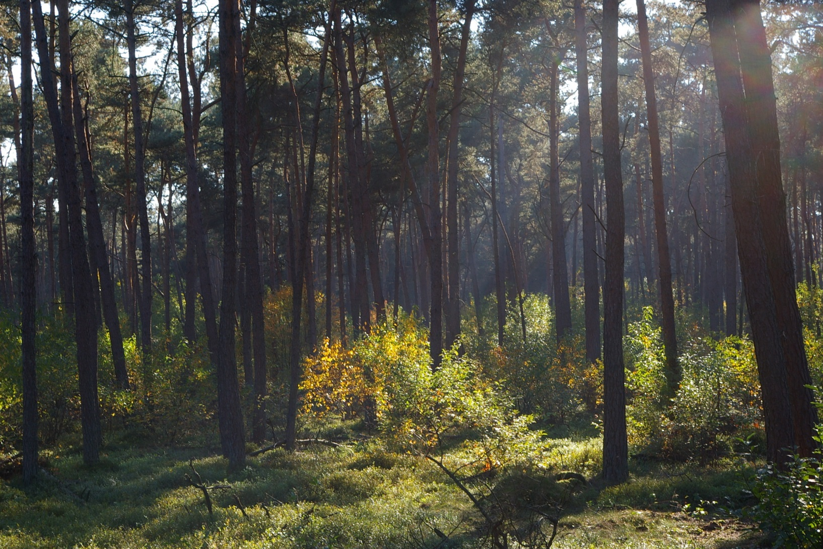
What forests are invadeable?
Former plantation pine forest in the Netherlands
Notes:
New England foresters are proud of black cherry rejuvenation

Slide 24
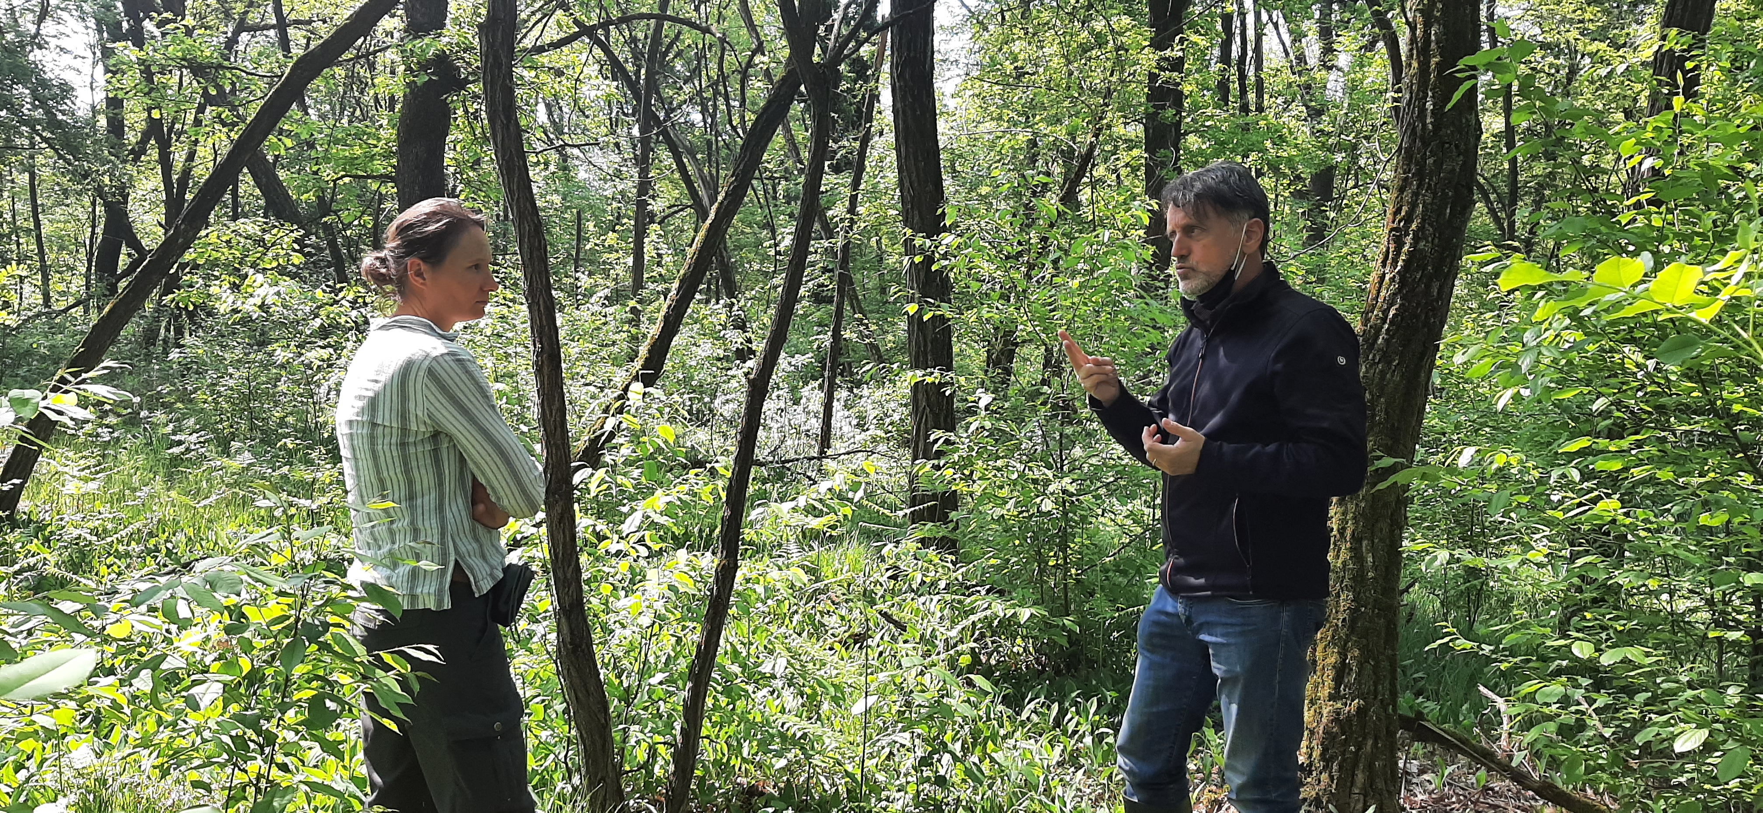
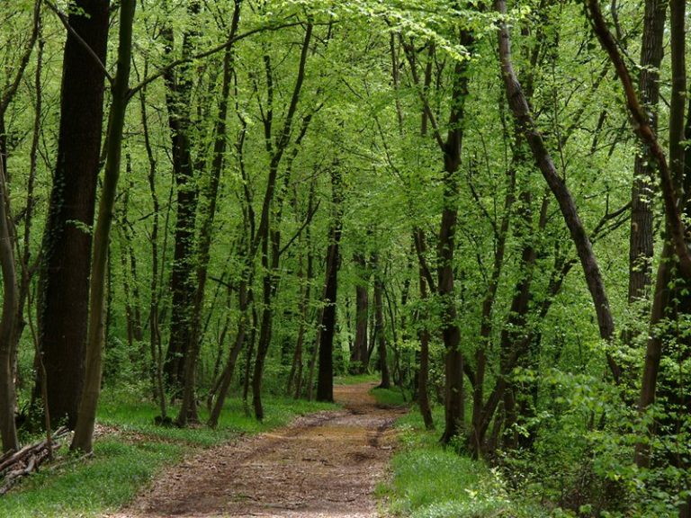
What forests are invadeable?
Recovering forest in the Valle del Ticino
Terwei, A., et al. (2013). "Which are the factors controlling tree seedling establishment in North Italian floodplain forests invaded by non-native tree species?" Forest ecology and management 304: 192-203.

Slide 25
Ecosystem Resilience Approach ERA
Preventing dominance
of invasive alien species by
strengthening the resilience
of forest and nature
The approach of the Ecosystem Resilience Approach (ERA) is to restore and manage forests to prevent invasive tree species to become invasive

Slide 26
Ecosysten RESILIENCE Approach
Ecological resilience = the ability of a (forest) ecosystem
to absorb disturbances, and
to reorganise itself during changes, while
maintaining functions, structure, identity and feedbacks
not necessarily with the same species composition.
Folke, C., et al. (2004). "Regime shifts, resilience, and biodiversity in ecosystem management." Annual Review of Ecology, Evolution, and Systematics: 557-581.

Slide 27
Forest Resilience mechanisms
  Forests have a high resilience.
  But this does not always lead back to the same forest type.
  Resilience on several levels:
  Individual persistence: resistance to stress, disturbance and competition.
  Recovery of the population: establishment of new individuals.
  Transformation of the ecosystem (Adaptation)
  Persistence and recovery lead to maintenance of the composition of the ecosystem (more or less!).
  Adaptation results in a new ecosystem. Desired or undesired.
Falk, D. A., et al. (2022). "Mechanisms of forest resilience." Forest ecology and management 512.

Slide 28
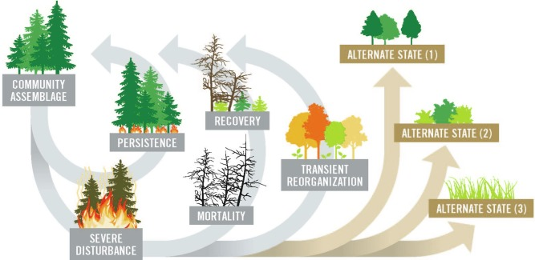
Forest Resilience mechanisms
Falk, D. A., et al. (2022). "Mechanisms of forest resilience." Forest ecology and management 512.

Slide 29
Forest resilience mechanisms that prevent invasive tree species from being invasive
Persistence
competition in time:
  invasive tree species (pioneers) are usually short-lived
  oak, pine, linden, ... live for centuries (normally!)
Recovery
Rejuvenation of tree species after disturbance (seed dispersal, root sprouts, light requirements, growth rate)
Rejuvenation under invasive tree species (presence of seed, shade tolerance)
Transformation
Closer to nature forest management (preserve forest climate)
Forest-goals adapted to new situation (N2000 habitats are annoyingly static)
Presence of tree species that can cope with the disturbance:
  invasive tree species
  climate change

Slide 30
Example: Rhine floodplain forests BW
Relatively dry forests on sandy soils.
Drought intensified by climate change.
Birch disappeared from the forest 10 to 20 years ago
The dominating Scots pine dies massively by Sphaeropsis sapinea / Diplodia pinea, induced by drought
Deteriorating health of beech and oak
Forest develops towards dominance of black cherry, black locust and red oak
Notes:
New England foresters are proud of black cherry rejuvenation

Slide 31
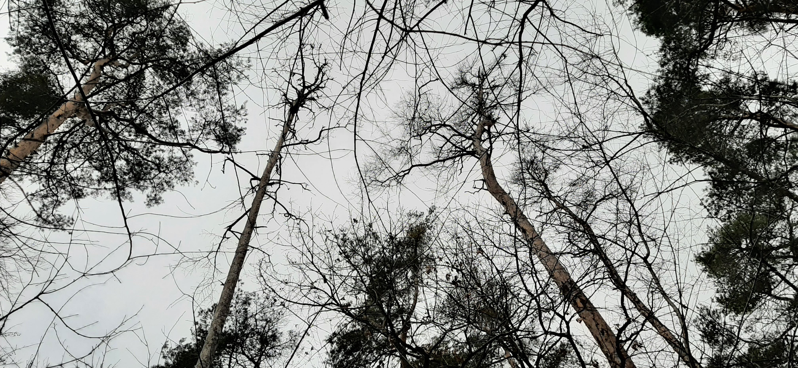
Example: Rhine floodplain forests BW
Notes:
New England foresters are proud of black cherry rejuvenation

Slide 32
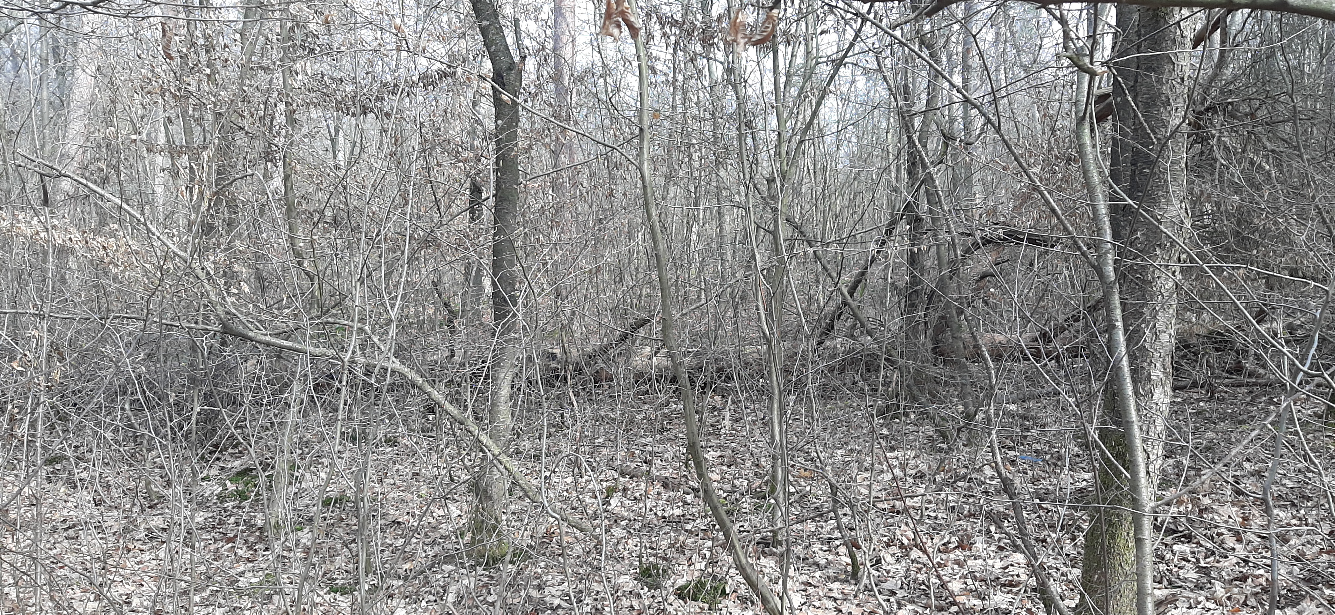
Example: Rhine floodplain forests BW
Notes:
Some rejuvenation of beech, hornbeam, sycamore maple and Norway maple

Slide 33
Two pathways
No intervention
Strengthening resilience
Jandl, R., et al. (2019). "Forest adaptation to climate change—is non-management an option?" Annals of Forest Science 76(2): 1-13.

Slide 34
Strengtening resilience to prevent invasive tree species from being invasive
Persistence
Select and release vital young trees:
  hornbeam, beech, sycamore, Norway maple (oak, pine).
  Where these are absent, select vital black cherry or black locust trees and release them (forest climate)
Recovery
Stimulate natural rejuvenation (browsing is a problem)
Underplant black cherry and black locust with oak, beech, hornbeam and maples (where rejuvenation is absent)
Transformation
Closer to nature forest management (preserve forest climate)
Adapt forest-goals to new situation (partly Weißmoos-Kiefernwaldes (Leucobryo-Pinetum))
Underplant with tree species adapted to (climate)change: Chestnut, winterlinden, silverlinden (Tilia tomentosa), Turkish hazel (Corylus colurna), oriental beech (Fagus arientalis), …
Notes:
The presented recovery is actually a transformation from pine dominated forest to broadleaved forest.

Slide 35
My own experience as forester / forest ecologist with black cherry, black locust and red oak
The more light demanding, the easier ERA :
Black locust: very easy
Black cherry: easy
Red oak: less easy
Main reasons:
Shade tolerance juveniles
Shade casting canopy
Nyssen, B. and J. Den Ouden (2021). "Quelle stratégie sylvicole pour le cerisier tardif? Mise au point d'un arbre de décision pour une espèce invasive." Forêt.Nature(158): 29-41.
Notes:
New England foresters are proud of black cherry rejuvenation

Slide 36
Species | Scientific name | Origin | Schade tolerance scale
1. Pine group |  |  | 50 –25 % of daylight
Japanese larch | Larix kaempferi | Asia | 1,38
European larch | Larix decidua | Europe | 1,46
Scots pine | Pinus sylvestris | Europe | 1,67
Black locust | Robinia pseudoaccacia | America | 1,72
Silver birch | Betula pendula | Europe | 2,03
Black pine | Pinus nigra | Europe | 2,10
2. Oak group |  |  | 25-10% of daylight
Aspen | Populus tremula | Europe | 2,22
Tree of heaven | Ailanthus altissima | Asia | 2,44
Pedunculate oak | Quercus robur | Europe | 2,45
Black cherry | Prunus serotina | America | 2,46
Ash | Fraxinus excelsior | Europe | 2,66
Sessile oak | Quercus petraea | Europe | 2,73
Red oak | Quercus rubra | America | 2,75
Douglas fir | Pseudotsuga menziesii | Amerika | 2,78
3. Maple group |  |  | 10 -5 % of daylight
Chestnut | Castanea sativa | Europe | 3,15
Field maple | Acer campestre | Europe | 3,18
Wild cherry | Prunus avium | Europe | 3,33
Ash-leaved maple | Acer negundo | America | 3,47
Hazel | Corylus avellana | Europe | 3,53
White elm | Ulmus laevis | Europe | 3,67
Sycamore | Acer pseudoplatanus | Europe | 3,73
4. Linden group |  |  | 5–2 % of daylight
Hornbeam | Carpinus betulus | Europe | 3,97
Large-leaved linden | Tilia platyphyllos | Europe | 4,00
Small-leaved linden | Tilia cordata | Europe | 4,18
Norway maple | Acer platanoides | Europe | 4,20
Norway spruce | Picea abies | Europe | 4,45
Beech | Fagus sylvatica | Europe | 4,56
Silver fir | Abies alba | Europe | 4,60
Amount of daylight seedlings and saplings need for establishing.
Niinemets, Ü. and F. Valladares (2006). "Tolerance to shade, drought, and waterlogging of temperate Northern Hemisphere trees and shrubs." Ecological Monographs 76(4): 521-547..

Slide 37
Transfer of ERA to tree of heaven and ashleaved maple
My prediction:
Tree of heaven, easy to integrate in most forest ecosystems
Ashleaved maple, more problematic
Complicating factors
Tree of heaven: allelophaty ?
Ashleaved maple: shade tolerance, shade casting?
Ecosystem resilience approach is custom-made:
case-by-case,
site-by-site,
goal-by-goal

Slide 38
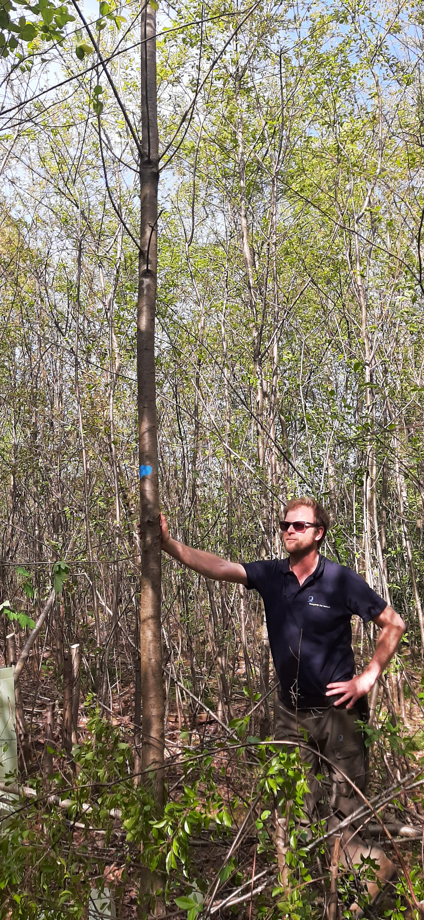
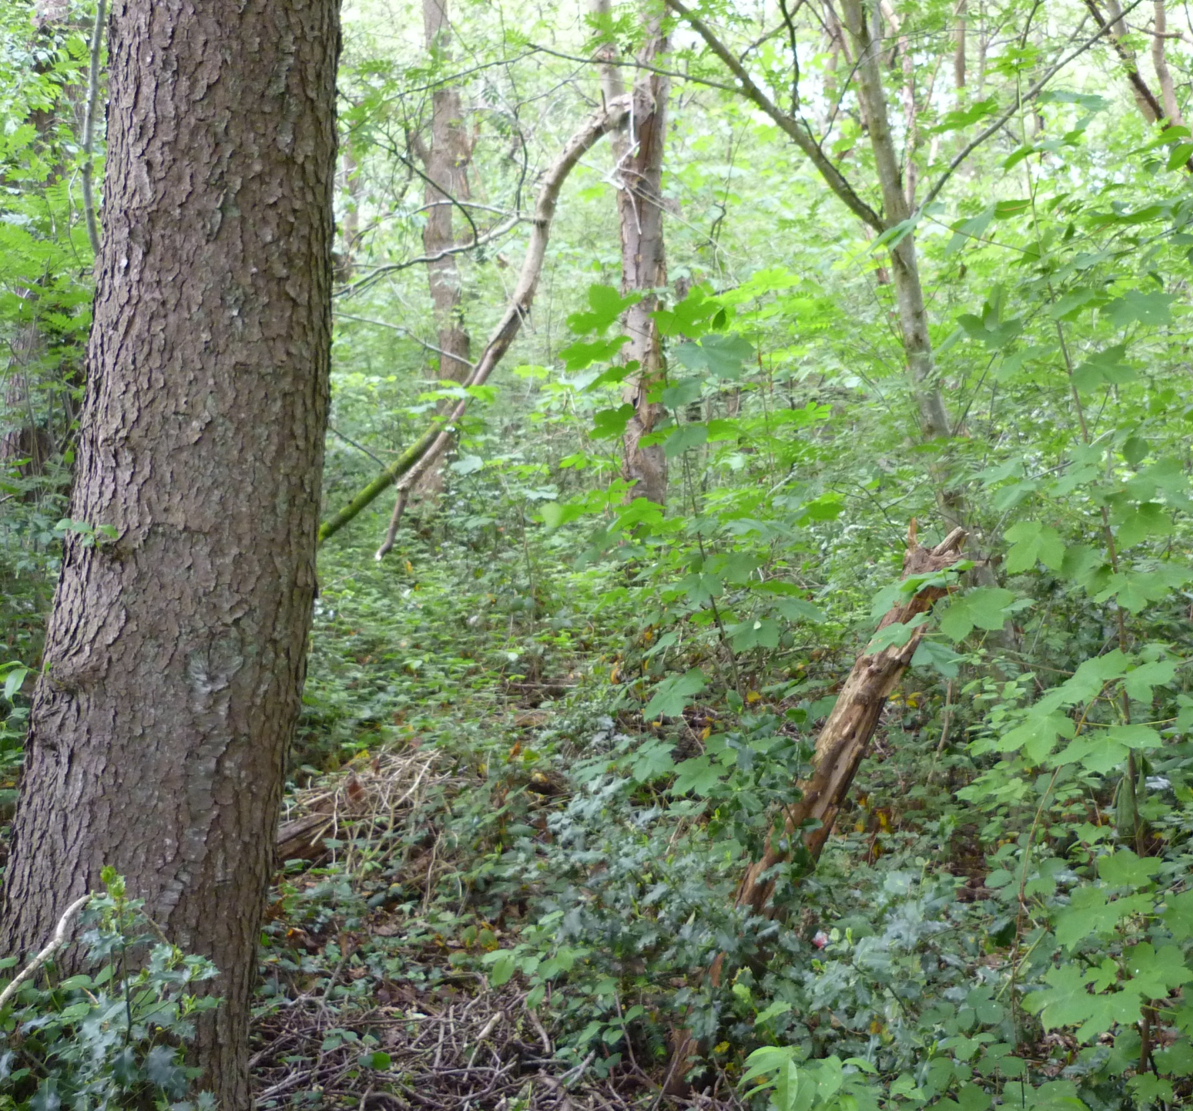
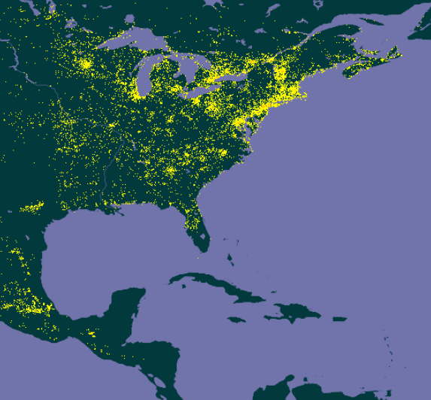
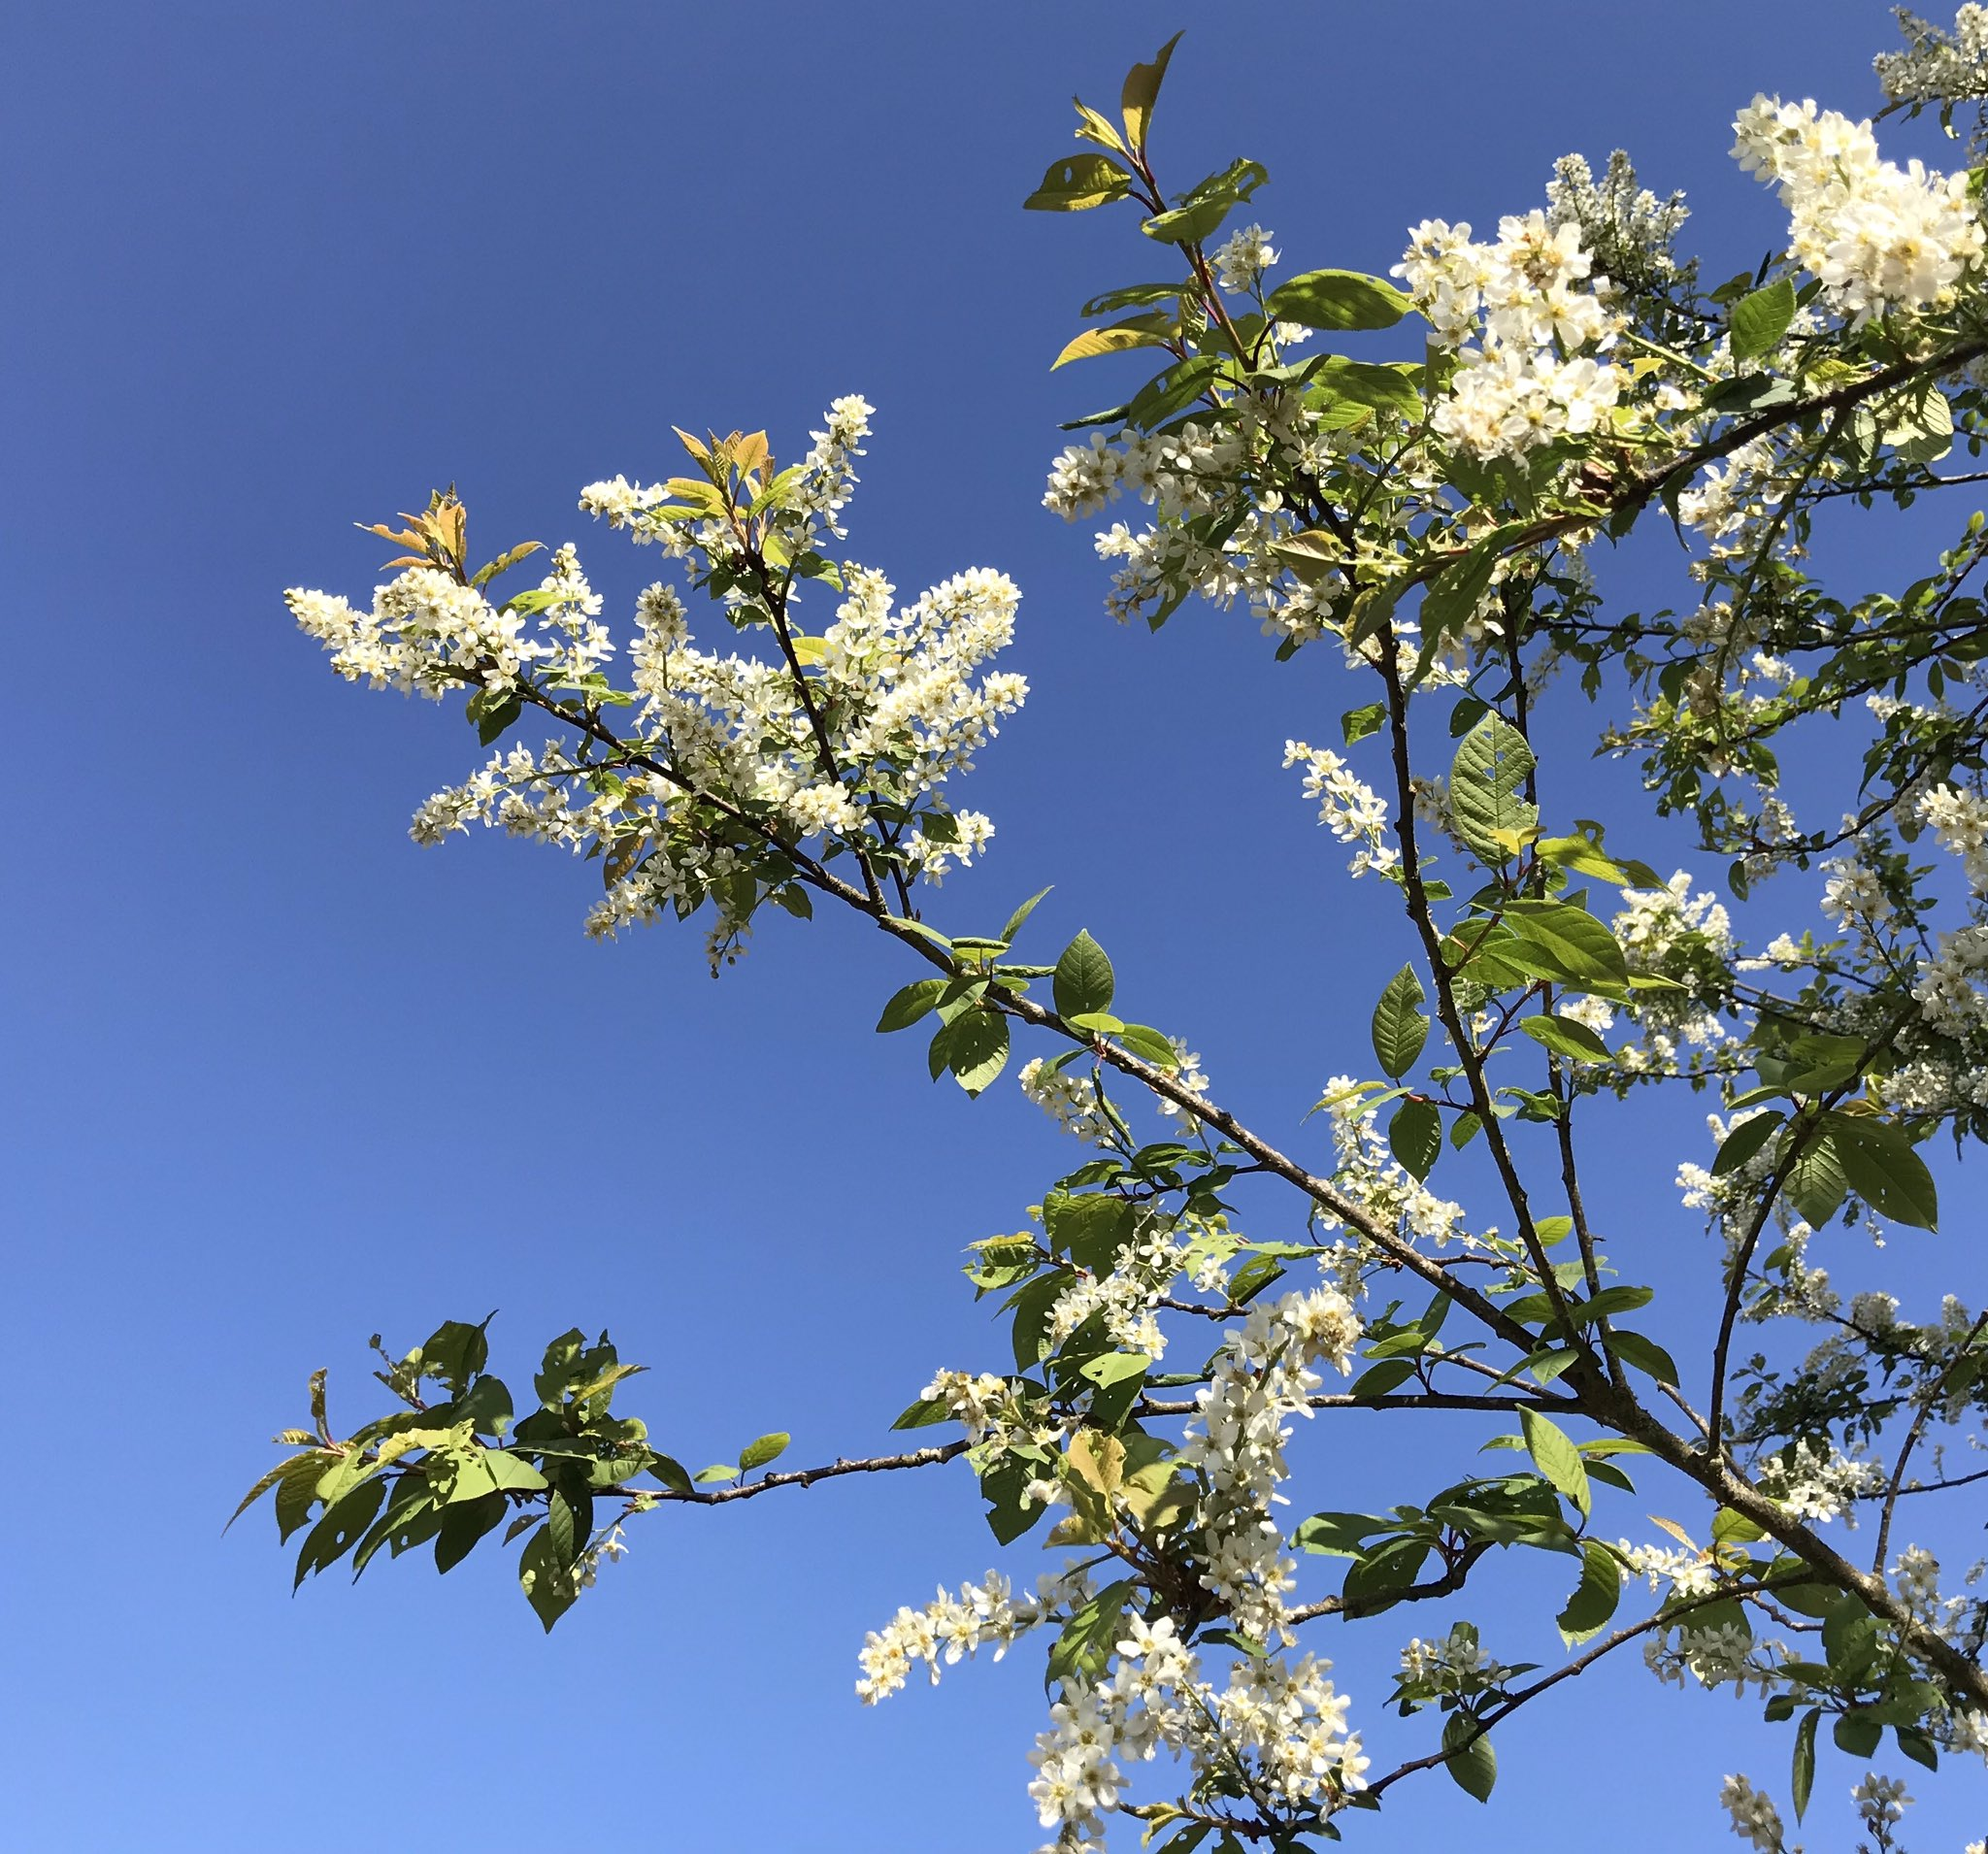
ERA frees the mind for ESS
Once their negative influences have been neutralised, we can think how pioneer (invasive) tree species (can) contribute to ecosystem services:
Biodiversity
Forest rehabilitation
Climate adaptation
Timber production
Nyssen, B. (2018). "Le cerisier tardif, nuisance ou espèce au potentiel intéressant ?" Silva Belgica 125(2): 18 - 27.
https://www.resilias.eu/en/news/english-presentation-black-cherry-alptrees-conferentie/

Slide 39
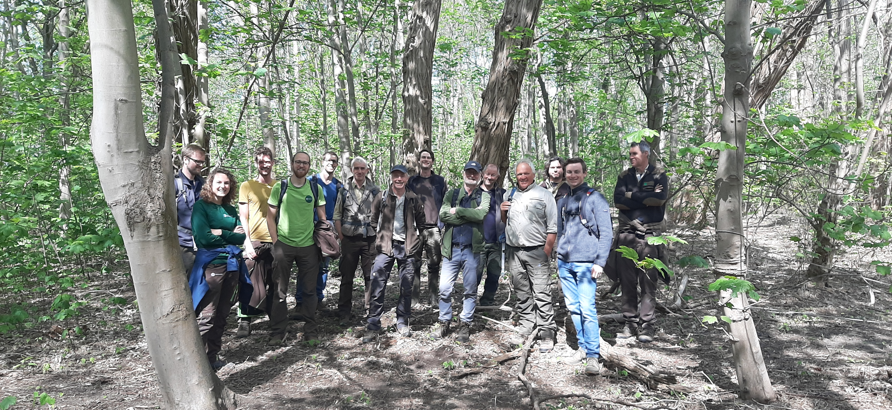
Black Locust forest on sandy soil, Near Antwerp (B). Secont tree layer of:
Acer pseudoplatanus
Acer platanoides
Castanea sativa
Tilia cordata
Do you know similar forests?
Ailanthus altissima
Acer negundo
Prunus serotina
Robinia pseudoaccacia
Quercus rubra
Please let me know!
Bart Nyssen b.nyssen@bosgroepen.nl

Slide 40
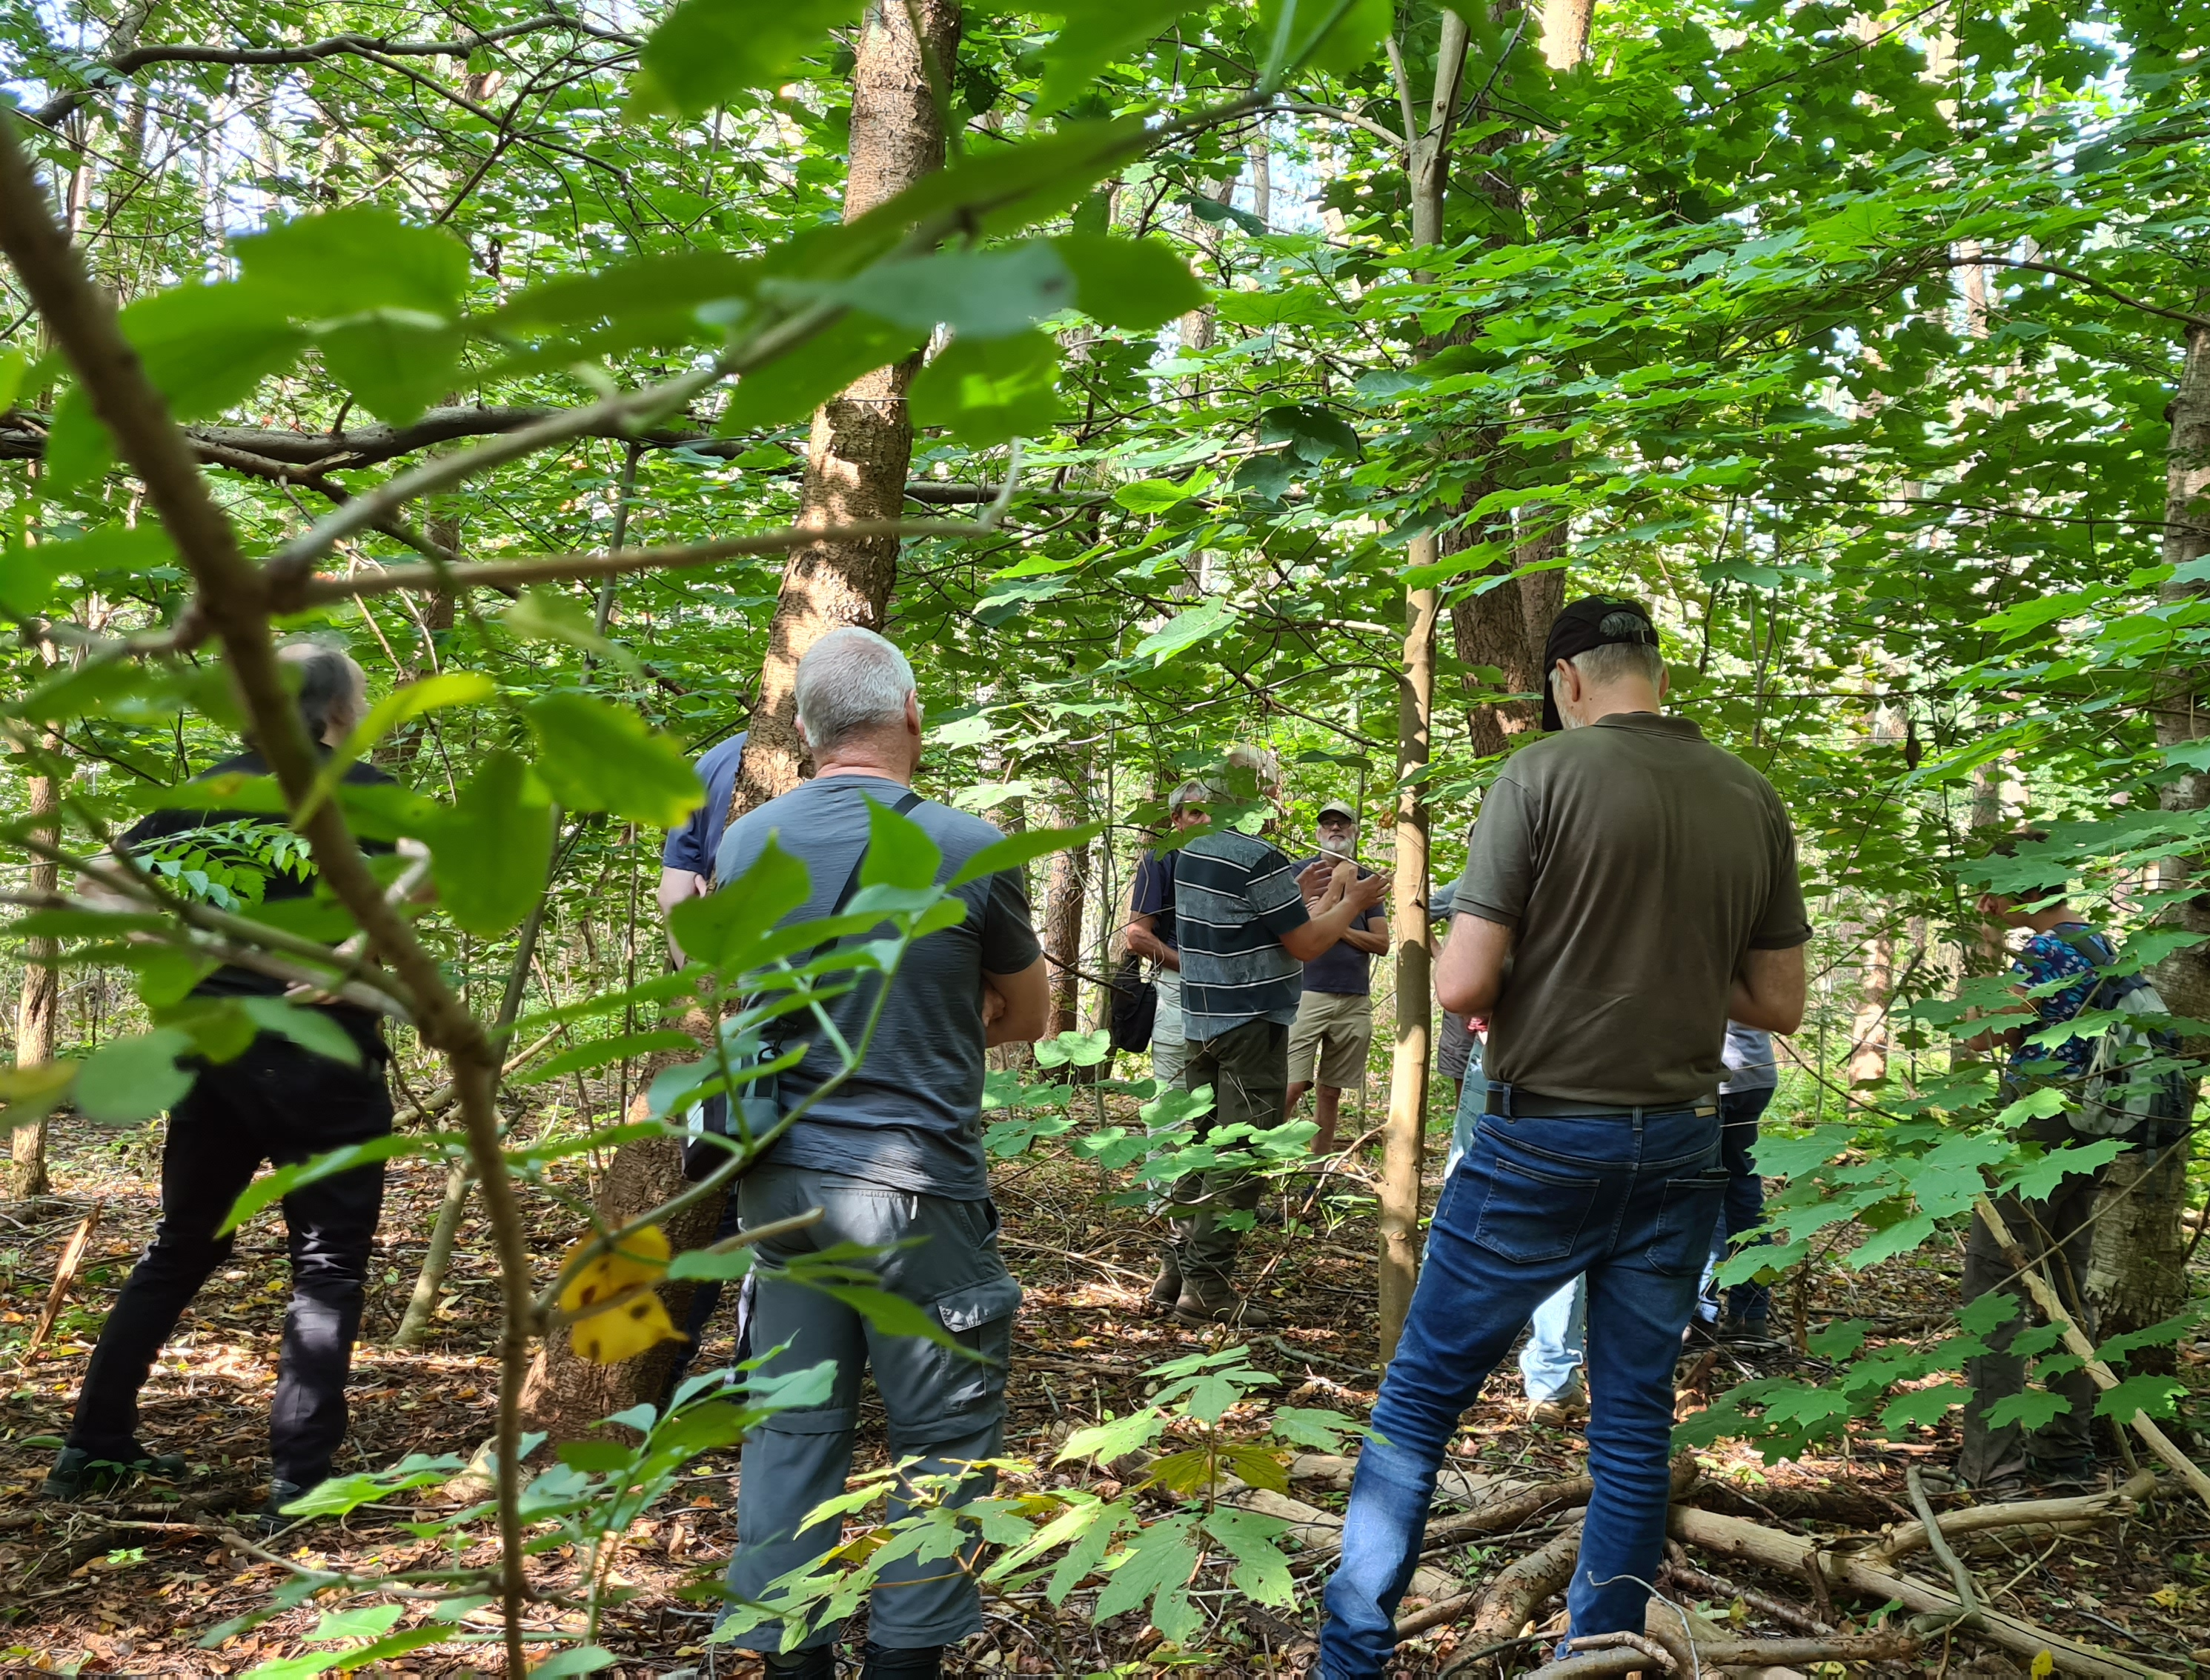
Thank you for your attention
Any questions?
https://www.resilias.eu/en/interesting-publications-and-presentations-black-cherry/
Bart Nyssen b.nyssen@bosgroepen.nl

